Slide 1

Crawl-E 2.0

Slide 2
What is Crawl-E ?
It is an abstract, re-usable, shared and extensible PYTHON capability which:
Can perform several flavors of searches/crawling.
Can search/crawl through Internal or External Artifacts/Documents.
Examples: Code Scripts, Documentation Artifacts, Published Articles, Social Media Platforms.
Candidate for Platform Engineering Services Offerings.
Can help in reducing operational risk.
Can help with ML Decision Models.
API Interface and results in JSONs.
Supports output as report, CSV and JSONs.

Slide 3
Features Ready
Token Search – Op Risk
Table Usage – Op Risk
What does it do?
Searches for a list of string tokens in list of (Code / Documentation) files or folders recursively.
Application/Use-Cases
Support and Automate Impact Analysis.
Improving operation efficiency.
Arguments
File/Folder List, Recursive Search (Y / N), File Type List, Name or Content (?), Token, Output Type
Returns (JSON)
File Name (With Path), Search Token, Line Number, Position
Standard Output Display Modes
Report, CSV, JSON
What does it do?
Reports table usage for code scripts in list of files or folders recursively for TD/CS Platforms.
Application/Use-Cases
Support and Automate Impact Analysis.
Improving operation efficiency.
Arguments
Codebase (TD/CS), File/Folder List, Recursive Search (Y / N), File Type List, Output Type
Returns (JSON)
File Name (With Path), DB Name, Table Name
Standard Output Display Modes
Report, CSV, JSON
News/Social Media Crawling – Credit Risk
Features
What does it do?
It crawls on news articles / social media posts and returns the articles metadata which can be used for feeding data into ML Decision / Ranking Models.
Application/Use-Cases
Credit/Risk ML Models
Arguments
Crawler Type – (NewsRiver, Twitter, WebHose, Reuters, YahooNews etc), Search Token(s), From Date, To Date
Returns (JSON)
JSON Object – publishDate, discoverDate, title, language, text, structured Text, url, elements, website, metadata, highlight, score

Slide 4
Web-Crawler Use-Case: Merchant Scoring

Slide 5
Web-Crawler Use-Case: Merchant Scoring
'''Searches for a string token in published articles ''' from CrawleeV2 import * #merchants = ['%22sears%20roebuck%22','toysrus','%22vasage%20international%22'] arg_entities = ['%22sears%20roebuck%22','toysrus', 'ZUPAS', '%22kb%20toys%22', 'amazon', 'walmart'] arg_token = '@@ENTITY%20AND%20%28text%3Abankruptcy%20OR%20text%3Aclosure%20OR%20text%3Amerger%20OR%20text%3A%22law%20suit%22%20OR%20text%3A%22new%20locations%22%20OR%20text%3A%22Year%20end%20financials%22%29%20' arg_crawler = 'NEWSRIVER' arg_from_date = '2018-10-01' arg_to_date = '2018-10-31' arg_var_list = '*' Cr_results = Cr_merchant_ers(arg_crawler, arg_entities, arg_token, arg_from_date, arg_to_date, arg_var_list)

Slide 6
Web-Crawler Use-Case: Merchant Scoring
Web-Crawler Results
"sears roebuck", 17.057852, 6, "If it fits; it must be his mitt", "https://www.thespec.com/sports-story/8937344-if-it-fits-it-must-be-his-mitt/"
"sears roebuck", 33.083965, 6, "Antitrust Mythology and the Decline of Sears", "https://www.cato.org/blog/antitrust-myths-decline-sears"
amazon, 18.60793, 7, "Prestigious Literary Group Sues Trump", "https://www.tvweek.com/tvbizwire/2018/10/prestigious-literary-group-sues-trump/"
amazon, 15.528445, 42, "Sears Files for Chapter 11 Bankruptcy", "https://www.i4u.com/2018/10/129707/sears-files-chapter-11-bankruptcy"
walmart, 18.921968, 42, "Sears; the Amazon of its day; files for bankruptcy", "https://www.engadget.com/2018/10/15/sears-chapter-11-bankruptcy/"
walmart, 18.6826, 42, "Sears files for bankruptcy protection", "https://adage.com/article/news/sears-files-bankruptcy-court-protection/315263/"
Merchant External Risk Score
"sears roebuck", 620.89
toysrus, 440.5
"walmart", 137.82
amazon, 197.52
Merchant Risk Profile
MERCHANT ENTITY | INTERNAL RISK SCORE (Internal sources) |  |  | EXTERNAL RISK SCORE (News / Social Media)
 | CDSS | TSR | Bureau | NEWS | SOCIAL MEDIA
Sears Roebuck | 11 | 12 | 650 | 621
Walmart | 10 | 7 | 500 | 138
Amazon | 3 | 5 | 720 | 198
ToysRUs | 10 | 9 | 610 | 441

Slide 7
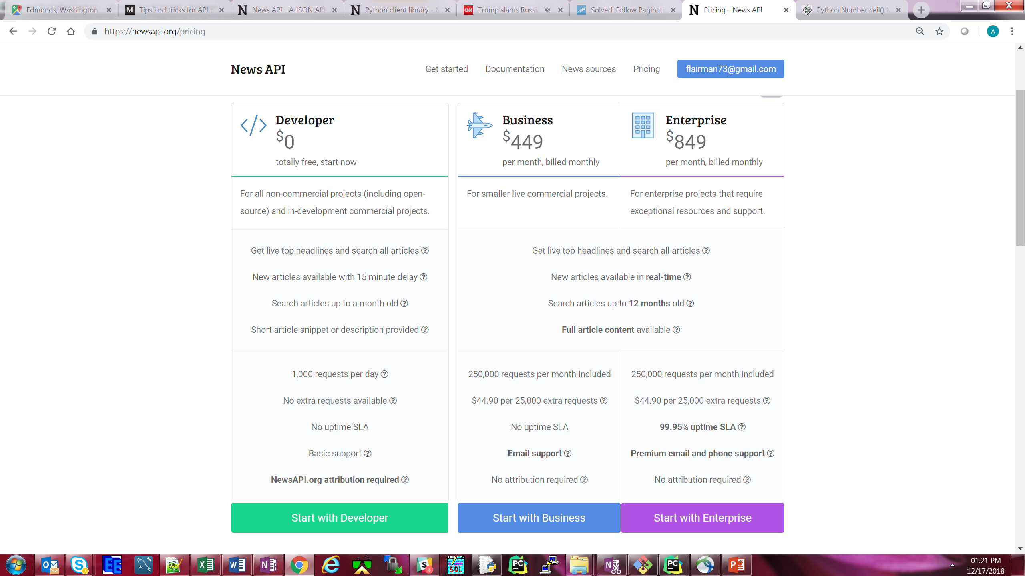
Crawler Observations
NewsRiver
NewsAPI
Twitter

Slide 8
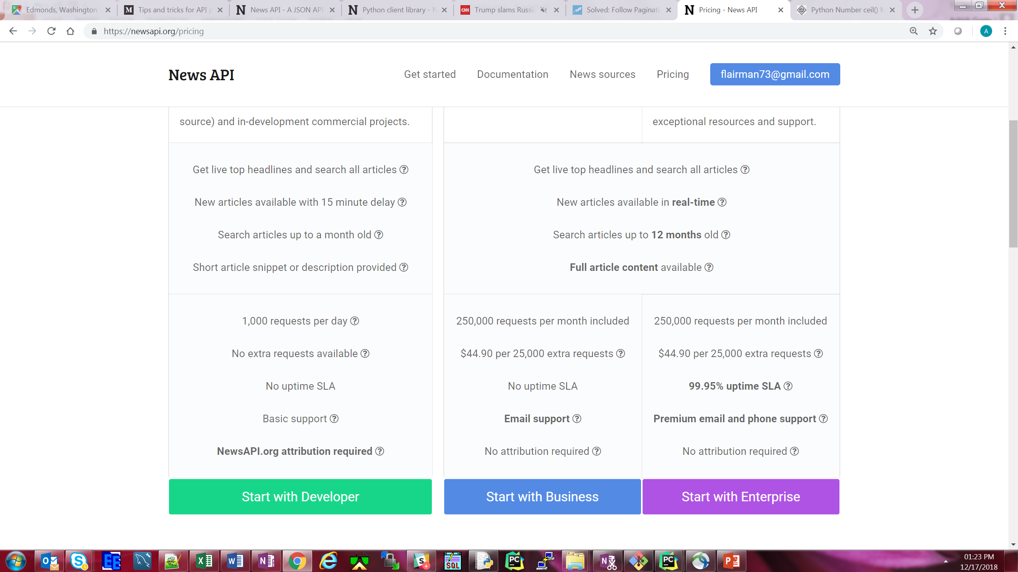
Crawler Observations - NewsAPI
News API
Past 30 data available only.

